Slide 1
WACV’2014
Real-Time Video Decolorization Using Bilateral Filtering
Yibing Song, Linchao Bao*, Qingxiong Yang
City University of Hong Kong
*Presenter

Slide 2


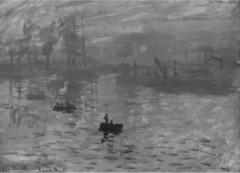
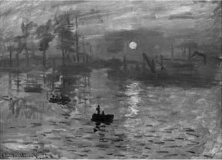



Input
Input
Bilateral Filtered
Bilateral Filtering
Joint Bilateral Filtering
Subtraction
Luminance
Our result
Residual
Detail loss estimation
Joint Bilateral Filtered

Slide 3
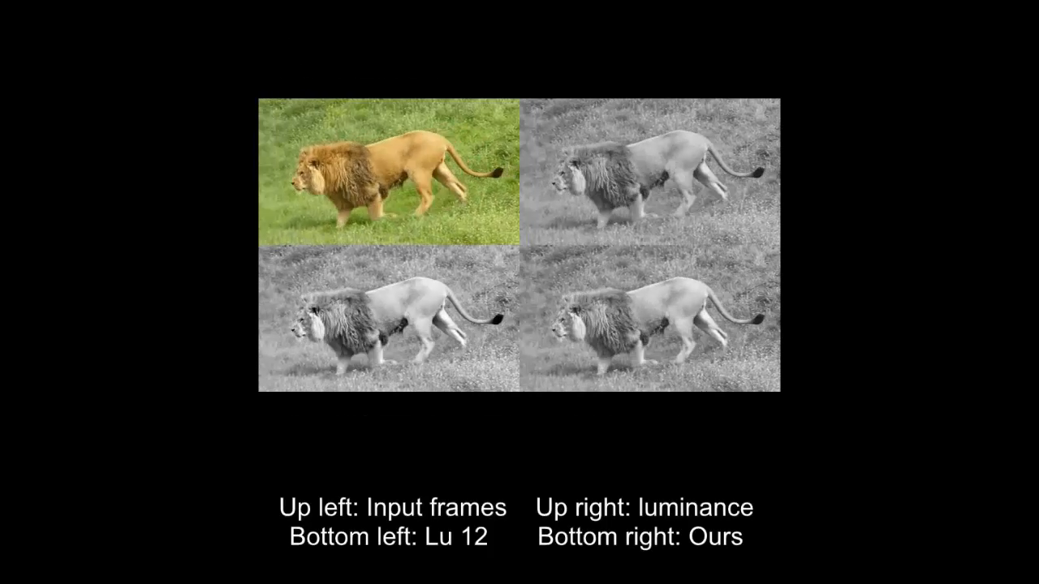

Slide 4
WACV’2014
Thank you!
Welcome to our poster!
Real-Time Video Decolorization Using Bilateral Filtering
Yibing Song, Linchao Bao*, Qingxiong Yang
City University of Hong Kong
*Presenter

